Slide 1
WELCOME

Slide 2





Meet Our Team
We believe in our team embodies this principle in every way. Our members hail from different walks of life, bringing unique perspectives, skills, and experiences to the table.
Ratre Akter
Rita Khatun
202322240320
Minara Jahan
202322240360
20232240308

Slide 3

Process
Scheduling!

Slide 4

What is Process Scheduling?

Slide 5





Process Scheduling(In Depth)
Process scheduling is a key function of the Operating System (OS) in a multiprogramming environment.
Key task
Work
Process scheduling is a key function of the Operating System (OS) in a multiprogramming environment.
It selects a process from the ready queue and assigns the CPU to it.
Efficiency
Performance
Ensures efficient CPU utilization and responsiveness.
It impacts the overall performance of the system significantly.

Slide 6

Minimize waiting time, turnaround time, and response time.
Maximize CPU utilization and throughput.
Scheduling Objectives
Assessing the Company's Financial Performance
Identifying Financial Problems
Measuring Operational Efficiency
Provide predictable performance and system responsiveness.
Ensure fairness so that no process is starved.

Slide 7

Types of Schedulers
01
02
03
Short-Term
Medium-Term
Long-Term
The scheduler that selects one of the ready processes in memory and allocates the CPU to it. It operates frequently and is responsible for switching between processes quickly and efficiently.
A component of the operating system that decides which processes are admitted into the ready queue. It controls the degree of multiprogramming by selecting a balanced mix of I/O-bound and CPU-bound.
A scheduler that temporarily removes (swaps out) processes from main memory to reduce the system load and improve performance. It later swaps them back when resources are available.

Slide 8

















SCHEDULING CRITERIA
CPU Utilization
Throughput
Turnaround Time
Keep CPU busy
Number of processes completed per unit time.
Total time taken by a process to execute.
Waiting Time
Response Time
Time a process spends waiting in the ready queue.
Time from submission to first output.

Slide 9
Scheduling Algorithms
2
4
First Come First Served
(FCFS)
Shortest Job First
(SJF)
Round Robin
(RR)
Priority Scheduling
1
3
5
Multilevel
Feedback
Queue
Multilevel
Queue
6

Slide 10
All processes are placed in the ready queue in the order they arrive.
First Come First Serve (FCFS)
The CPU scheduler picks the process at the front of the queue.
First Come First Serve (FCFS) is the simplest and oldest CPU scheduling algorithm. As the name suggests, the process that arrives first in the ready queue is executed first.
The selected process runs until it completes or terminates.
The next process in the queue is selected, and so on.

Slide 11

Real Life Example & Gantt Chart
Pb
 | Px | ……………………………. | Pb | Pa
CPU

Slide 12







Shortest Job First (SJF)
Picks process with the shortest CPU burst.
Can be preemptive or non-preemptive.
Shortest Job First (SJF) is a CPU scheduling algorithm that selects the process with the shortest CPU burst time for execution first.
Optimal for minimizing average waiting time.
Hard to predict next burst time, starvation possible.

Slide 13









Real Life Example
I just want to book a flight Ticket.
I want to play Free Fire. My friends are Waiting.
I want to place an order for Grocery.
I want to see Cartoon.

Slide 14
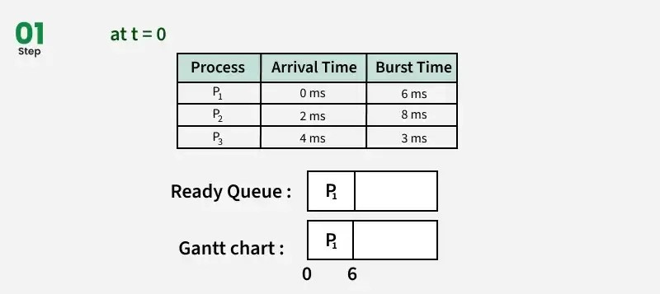
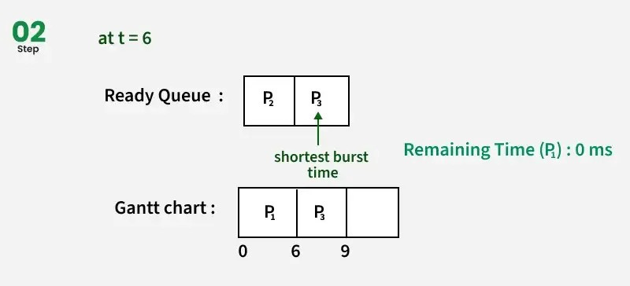
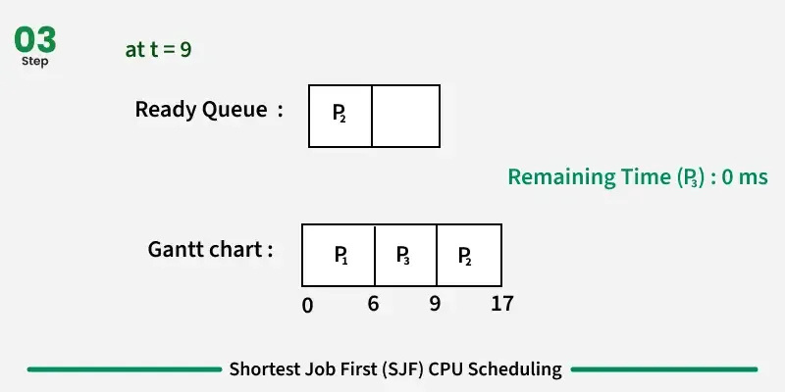
Example

Slide 15





Borcelle
Round
Robin!
Company
How It Works:
Processes are arranged in a circular queue.
Round Robin (RR) is a preemptive scheduling algorithm where each process is assigned a fixed time slice (quantum). Once a process uses its quantum, it is preempted and moved to the back of the ready queue, giving others a chance to run.
CPU executes the first process for a fixed time quantum.
If not finished, the process is placed at the end of the queue.
Type: Preemptive
CPU moves to the next process, and the cycle continues.

Slide 16







Real life example!
How to share the bicycle among all friends?

Slide 17
How It Works!
P1
Pn
P2
P1
P2
…..
Pn
….
P3
Ready Queue
Circular Ready Queue

Slide 18


Priority Scheduling!
Each process is assigned a priority.
A higher-priority process interrupts a running lower-priority one.
Preemptive
Process with higher priority is executed first.
Non-Preemptive:
Once a process starts, it runs until completion, regardless of new arrivals.
Starvation:
Low-priority processes may never execute if high-priority tasks keep arriving.

Slide 19







Real life Example!
Hospital

Slide 20
Algorithms
Type
Preemptive
Fairness
Starvation
Non-Preemptive
No
Low
NO
FCFS
SJF
Both
Optional
Low
Yes
Priority
Both
Optional
Medium
Yes
Round Robin
Preemptive
Yes
High
No

Slide 22






Why is Process Scheduling Important?
CPU is one of the most valuable and expensive resources.
Helps in achieving maximum CPU utilization.
Provides responsiveness in interactive systems.
Balances the needs of different users and system goals.

Slide 23







Where Scheduling Is Used?
Operating Systems:
Mobile Operating Systems:
Web Servers & Cloud Systems:

Slide 24
Thanks

